Slide 1
1
The Environment and Sustainability
Notes:
Photo © Borut Trdina/iStockphoto

Slide 2
Sustainability Defined
The ability of Earth’s natural systems and human cultural systems to survive, flourish into the long-term future

Slide 3
1.1 What Are Some Key Factors of Sustainability?
Life on Earth:
Has been sustained for 3.8 billion years by solar energy, biodiversity, and nutrient cycling
Depends on energy from the sun and natural capital provided by Earth
Can be preserved by shifting toward full-cost pricing and win-win solutions

Slide 4
Environmental Science Is a Study of Connections in Nature
What is the environment?
Everything around us, biotic factors (living) and abiotic factors( nonliving) examples?
What is environmental science?
Interdisciplinary study of how humans interact with the environment (draws on engineering, natural sciences, social sciences, ethics)
Environmentalism:
A social movement dedicated to sustaining Earth’s life-support system.
Ecology:
-The branch of Biology that focuses on how living things interact with the non-living parts of their environment.

Slide 5
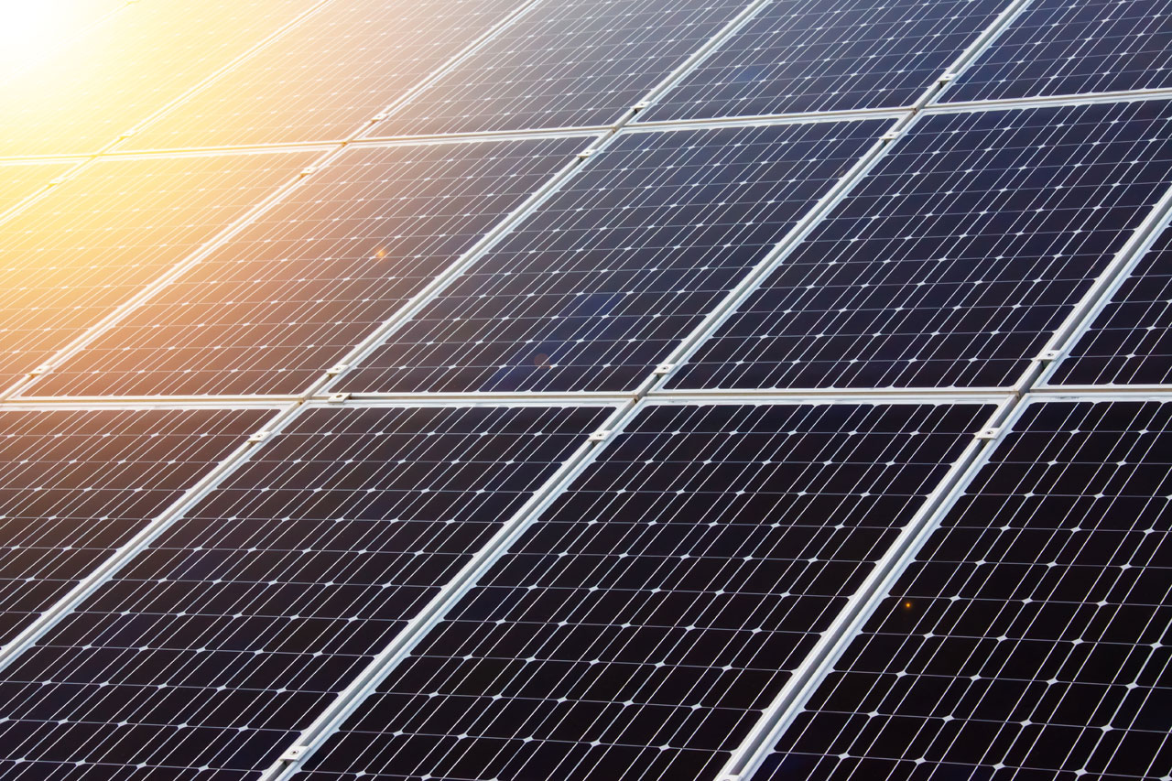
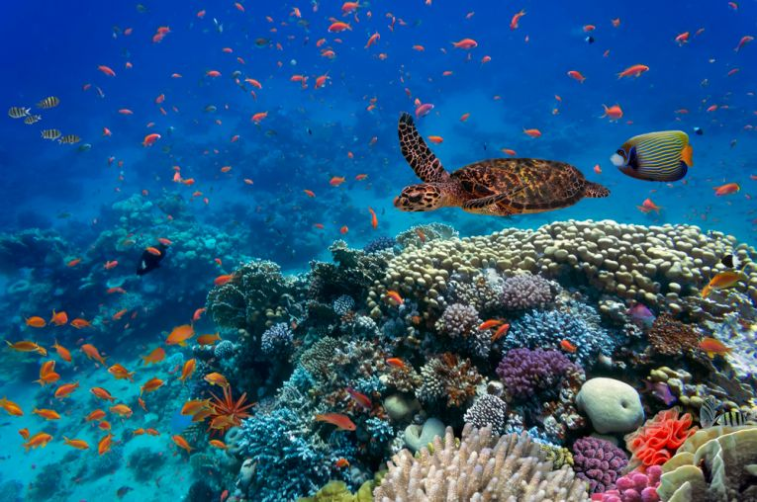
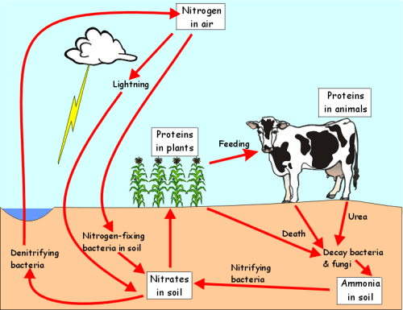
Scientific Factors of Sustainability
Solar Energy
Supplies nutrients, directly and indirectly
Biodiversity
Provides ecosystem services and adaptability
Nutrient cycling
Cycling of life-giving nutrients/chemicals between organisms and environment
Examples – water, carbon, and nitrogen cycles

Slide 6
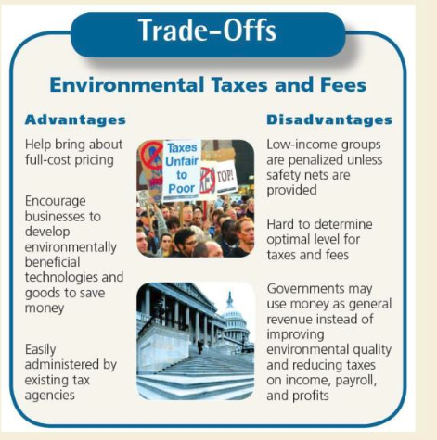
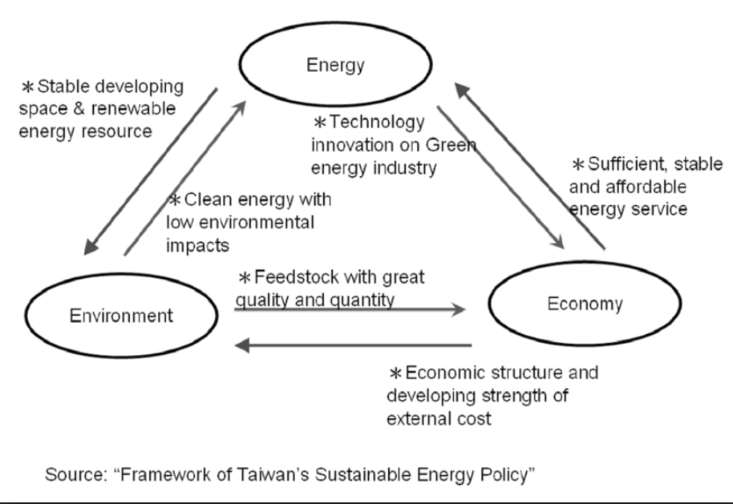
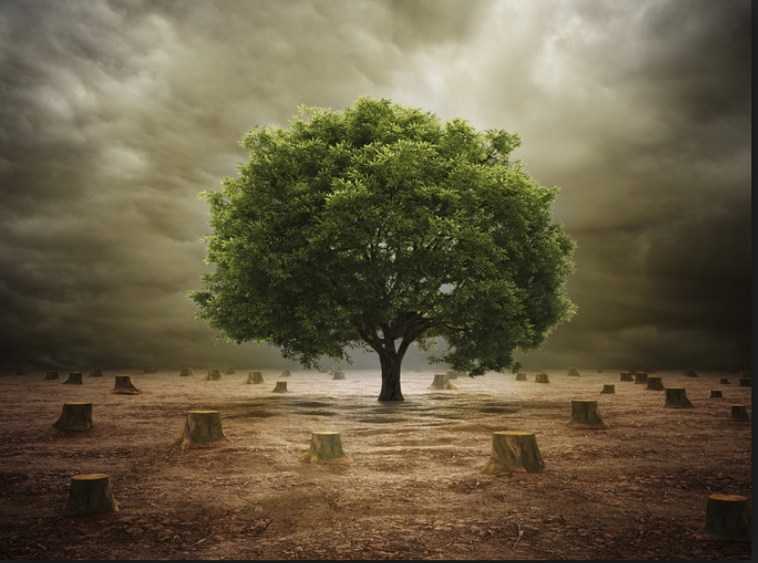
Social Factors of Sustainability
Economics
Full-cost pricing to include environmental and health costs of producing goods/services
Political Science
Win-win solutions to environmental problems
Ethics
A responsibility to protect Earth for future generations
This Photo by Unknown Author is licensed under CC BY

Slide 7
Environmental Impact caused by humans stations
In this Explore activity, students will participate in stations to identify and explore the many environmental impacts caused by humans.
Students get into teams of two.
Handout the Student Guide and Student Journal, one per team. Assign each team a starting station.
Students should read the background information and then start at the station to which they were assigned.
Students should complete all of the stations. If there is no station open when students finish a station, they should return to their desks and wait until a station becomes available.
When students finish their stations, they should complete the Reflections and Conclusions.

Slide 8
Sustainability and Natural Capital
Natural capital = Natural resources + Ecosystem services
Natural resources
Natural materials and energy sources essential or useful to humans
Three types are inexhaustible, renewable, or nonrenewable
Ecosystem Services
Free natural services provided by healthy ecosystems; support human life/economies
Examples are pollution, nutrient cycling, water purification

Slide 9
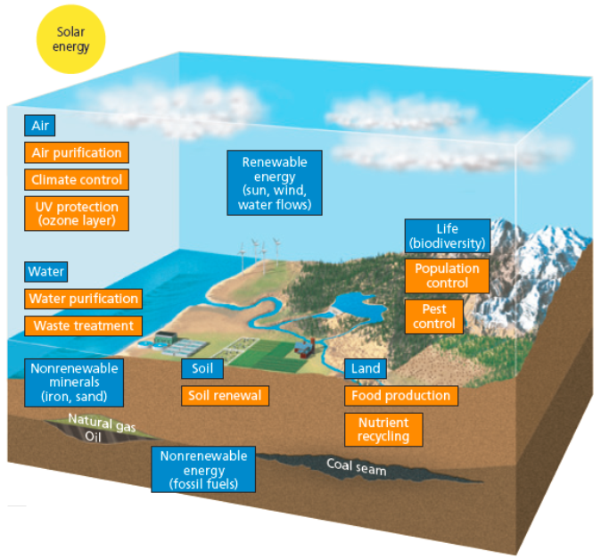
Natural Capital = Natural Resources + Ecosystem Services
Notes:
Earth’s Natural Capital: Natural capital consists of natural resources (blue) and ecosystem services (orange) that support and sustain Earth’s life as well as human economies.

Slide 10
Natural Capital: Challenges and Solutions
How do Humans Degrade Natural Capital?
By using renewable resources faster than nature can restore them
By overloading natural resources with pollution and waste
Solutions can Protect Natural Capital
Scientific (environmental scientists) vs. economic and political solutions (social scientists)
Trade-offs and compromises because of conflicts having a negative economic effect on groups of peoples or industries.
Daily individual and local contributions matter

Slide 11
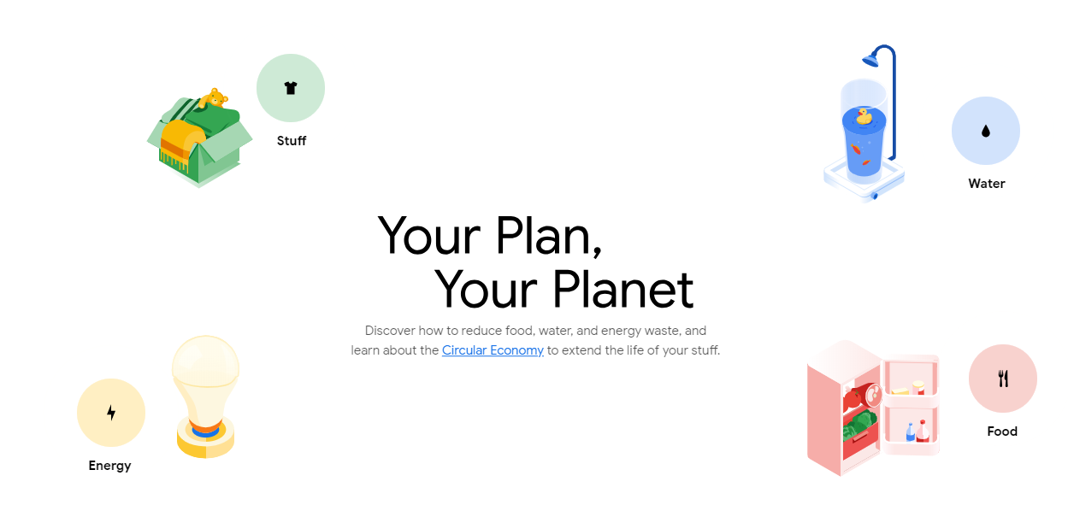
Sustainability: How Our Actions Affect the Environment
Notes:
Complete the 5E lesson Sustainability: How Our Actions Affect the Environment

Slide 12
1.2 How Are Our Ecological Footprints Affecting Earth?
Humans have the power to degrade or sustain Earth’s life-support system.
Over time, growth of ecological footprints depletes and degrades Earth’s natural capital.
There is good new and bad news.

Slide 13
Many People Have a Better Quality of Life
Humans have learned to transform raw materials into useful goods and services.
Globally, life spans are increasing; infant mortality is decreasing.
Improved food supply, air/water quality, access to education, disease prevention
Some species and ecosystems are being successfully protected.
Technology is improving communication.

Slide 14
Humans Are Living Unsustainably
Environmental Degradation
Waste, depletion, degradation of natural capital
Tragedy of the commons: large numbers of people exploit a shared/open access resource unsustainably
Human activities have overused about 60% of Earth’s ecosystem services, mainly since 1950.

Slide 15
What is an Ecological Footprint?
Ecological footprint: (pg. 25 map)
The amount of land and water needed to supply an individual or a population with renewable resources and to absorb/recycle wastes and pollution such resource use produces
Growth of ecological footprints:
Leads to degradation of natural capital
Results in the creation of pollution and waste

Slide 16
Our Ecological Footprints Are Growing
Ecological deficit
Occurs when the ecological footprint is larger than the biological capacity to replenish resources and absorb wastes/pollution
An ecological deficit indicates that humans are living unsustainably.
Globally, humans are running up a huge ecological deficit that is expected to keep growing.

Slide 17
Pollution Causes Environmental Problems
Pollution: contamination of the environment by any polluting substance (pollutant)—such as chemicals, noise, heat—at levels considered harmful to health, survival, activities of organisms
Naturally occurring (volcanoes)
Contributed by humans (burning of fossil fuels)

Slide 18
Sources of Pollution
Point Source
Single, identifiable source from which pollutants are discharged
Examples: smokestacks, motor vehicles, chimneys, drainage pipes
Nonpoint Source
Dispersed sources, difficult to pinpoint
Examples: runoff from farm fields, trash in streams, deposition of air pollutants on land

Slide 19
How Are We Dealing With Pollution?
Pollution cleanup (post-production)
Cleanup: dilution/reduction of pollutants
Pollution prevention (before pollution occurs)
Reduces or eliminates the production of pollutants

Slide 20
1.3 What Causes Environmental Problems and Why Do They Persist?
Environmental and social scientists have identified five basic causes of the environmental problems' society faces.
1. Population growth – exponential- starts slowly and increases at a fixed percent per unit of time. It starts slowly but after a few doublings grows to an enormous numbers.
2. Unsustainable resource use because of affluence - when a high level of resource consumption exists because people are earning higher incomes.

Slide 21
1.3 What Causes Environmental Problems and Why Do They Persist?
3. Poverty can cause degradation of the environment and lead to unhealthy conditions.
4. Lack of full-cost pricing for goods/services. Subsidies given to industries help the economy but degrade the environment.
5. Increasing isolation from nature – too much technology is not necessarily a good thing.

Slide 22
1.4 What Is an Environmentally Sustainable Society?
In order to live sustainably, one must live off the natural resources without depleting or degrading the natural capital that supplies these natural resources.
Natural income is the portion of renewable resources that can be used sustainably.
By living only on Earth’s natural income and not depleting the natural capital, society moves from an unsustainable lifestyle to a sustainable one.

Slide 23
A More Sustainable Future Is Possible
Given enough time, most degraded environments can recover, but many will take hundreds and even thousands of years to recover.
Time is our most scarce resource.
However, 5–10% of a population that changes can make a difference.
Changes can occur in a shorter time than previously thought.

Slide 24
Environmental Conservationists and Preservationists in the United States
Conservationist movement founded by George Perkins Marsh.
- He was a scientists and member of Congress from Vermont.
- He believed that America’s resources were not inexhaustible.
The Preservationist movement split off of the conservationist's movement in the early 19th century. They believed that some wilderness areas on public lands should be left untouched and preserved forever.

Slide 25
Tragedy of the Commons Lab
In Groups of 3-4 at a lab station:
•You and your partners will fish in a communal lake
•You will fish once per year for five years
•Each fishing season lasts 10 seconds
•Nine fish are needed each season for your survival
•Surviving fish reproduce, but the lake cannot exceed 120 fish
Game 1- NO TALKING Game 2- YOU MAY TALK
Notes:
Complete Tragedy of the Commons Lab

Slide 26
Science 1968
Garrett Hardin’s Tragedy of the Commons
•"Freedom in a common brings ruin to all."
•Shared resources are considered “the commons”
•A “Tragedy” develops whenever a finite resource is being consumed at a steady or increasing rate.
•Welfare “cheats” commons by handicapping the population- if you’re struggling, here’s $$
Can you come up with examples of modern commons?
Notes:
Complete Tragedy of the Commons Lab

Slide 27
The Great Pacific Garbage Patch (GPGP):
A real life “Tragedy of Commons”
Oprah Documentary
http://www.youtube.com/watch?v=FTurihxSTnI
Picture Slideshow
http://www.youtube.com/watch?v=y5y1W5xduiE
Is there a solution to “Tragedy of the Commons?
Notes:
Complete Tragedy of the Commons Lab

Slide 28
Tragedy of the Commons Is there a solution?
Privatization- Creates incentive for individuals to minimize abuse of commons
Restrict Access through rules/regulations
Trout stamps, water rights for irrigation, catch limits
Changing our values/lifestyle: The best solution, but most difficult to achieve
The power of the consumer…
Notes:
Complete Tragedy of the Commons Lab

Slide 29
Consumerism
The decisions you make as a consumer can have enormous impact on the environment
Food: why buy organic? Why go vegetarian or vegan?
Energy: would you pay extra for solar?
Packaging: How much plastic do you purchase through packaging?
Transportation: hummers vs. hybrids, function vs. fashion
What do you value? What does your family value?
Notes:
Complete Tragedy of the Commons Lab

Slide 30
Consumerism
The decisions you make as a consumer can have enormous impact on the environment
Can we measure what you consume?
Notes:
Complete Tragedy of the Commons Lab

Slide 31
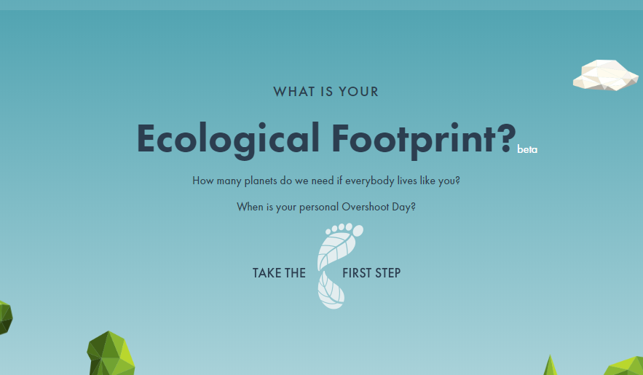
Ecological Footprint

Slide 32
1
Environmental Problems,
Their Causes, and Sustainability

